Slide 1
Tank World
Weiguang Zhou
100136054

Slide 2
Agenda
Requirements
Technical Solutions
Demo

Slide 3
Requirements
Not a game for fun
A game played by computers(AIs)

Slide 4
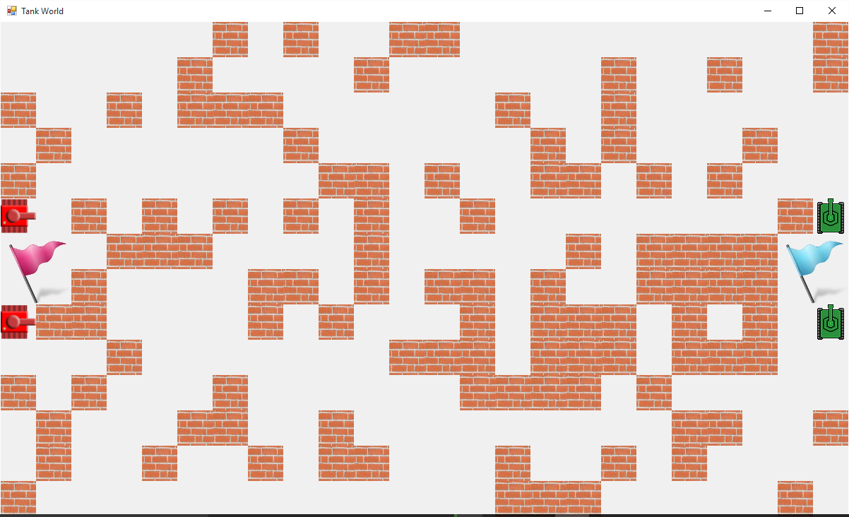
Requirements

Slide 5
Requirement - Terminology
Round
Action
Fire
Turn
Turn right, left or back
Forward

Slide 6
Requirement
External AI

Slide 7
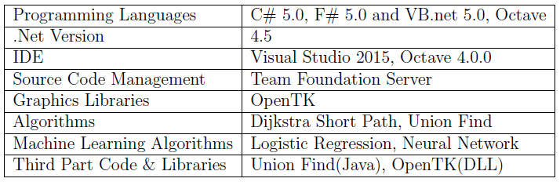
Technical Solutions
Summary

Slide 8
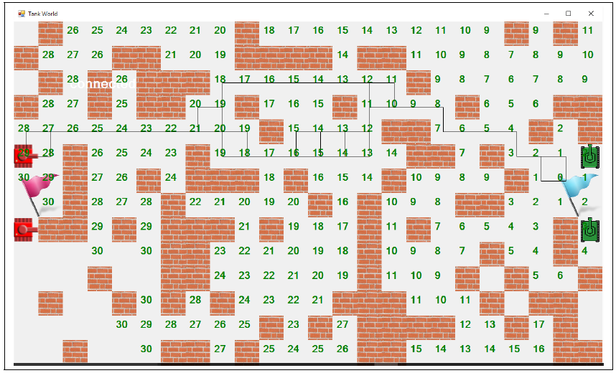
Technical Solutions
Shortest Path – Dijkstra’s Algorithm

Slide 9
Technical Solutions
Players
Wanderer
Flag Remover
Programmed Player
Logistic Regression
Neural Network

Slide 10
Technical Solutions
Machine Learning
Classification
Fire
Move Forward
Turn Left
Turn Right
Turn Back

Slide 11
Technical Solutions
External AI
Use Plugins

Slide 12
Demo

